Slide 1
Cyberwar: A Beginner’s Guide
Jeff Chase
Duke University

Slide 2
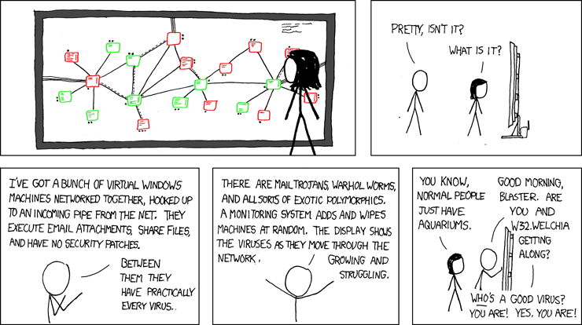
Pathogens: Life in a petri dish
[xkcd.com]

Slide 3
Cyberwar: hi-stories and lessons
Threat groups: professional and well-resourced.
Names: APT1, Sandworm, EquationGroup.
Analysts study how their tactics and tools evolve over time.
Attribution of attacks to teams is a challenge in itself.
Tools: modular threat platforms, hybrid attack chains.
Deploy by initial intrusion, self-conceal, open backdoor for command/control, spread internally, map target.
targeting payload. BlackEnergy, Industroyer, StuxNet
Targets: physical infrastructure.
Power grids, military sites, transportation, medical.
Slouching toward a Hobbesian future?

Slide 4

Step 1: Breach!
How to gain access for the initial intrusion?
Compromise a user account (e.g., admin).
Attack an RCE vulnerability over the net.
Trojan: drive-by install, thumb drive, or corrupted software update.

Slide 5
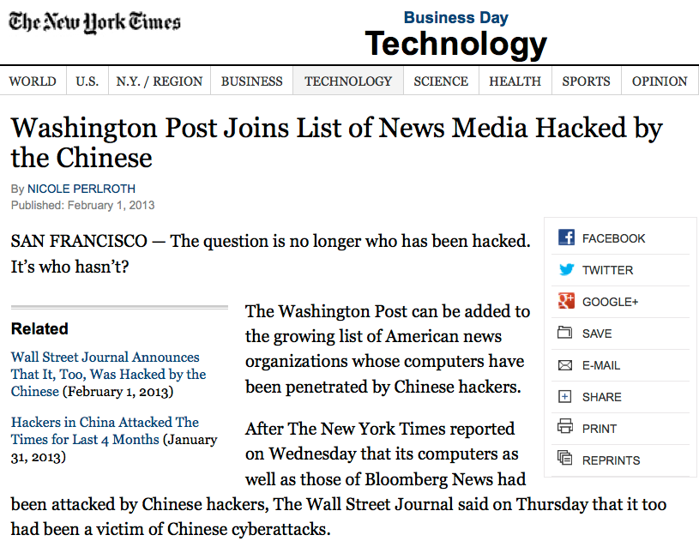

Slide 6
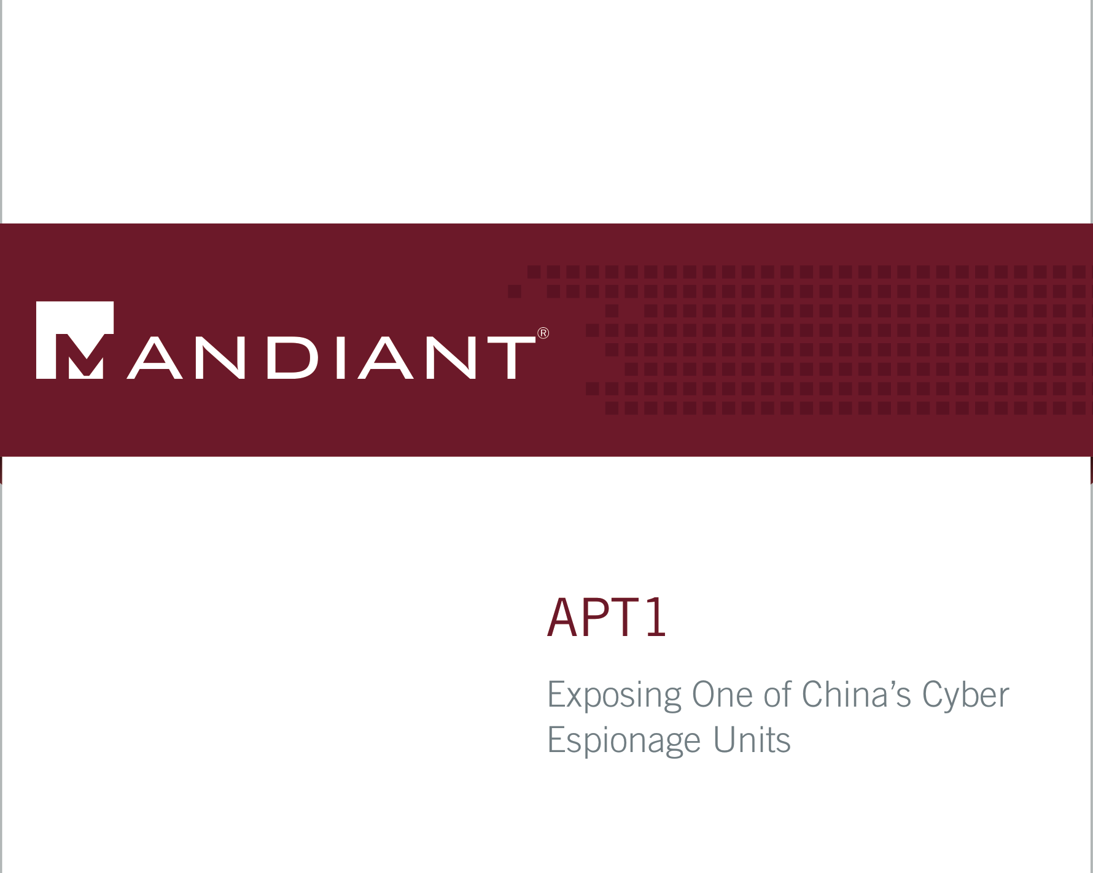
2/19/13
Advanced Persistent Threat

Slide 7

Initial compromise
The Initial Compromise stage represents the methods that intruders use to penetrate a target organization’s network. APT intruders frequently target individual users within a victim environment. As such, the most commonly observed method of initial compromise is spear phishing. Spear phishing messages may contain malicious attachments, a link to a malicious file, or a link to a malicious website. Less commonly, APT intruders may attempt to contact potential victims and send malicious content via social networking sites or instant messaging. … [also web attacks: drive-by downloads]
APT groups may also look for vulnerable Internet-facing web servers and upload webshells in order to gain access to a target’s internal network, or look for other technical vulnerabilities in public-facing infrastructure.
^{P63 appendix}

Slide 8
Spear phishing
Phishing is a social engineering attack.
E.g., the Podesta gmail attack in 2016 US election.
Malice-in-the-middle
Spear phishing is a more sophisticated phish attack targeted at a specific individual.
E.g., the attack message is designed to look like a communication from a trusted associate of the victim.
Based on intelligence gathered on the target.

Slide 9
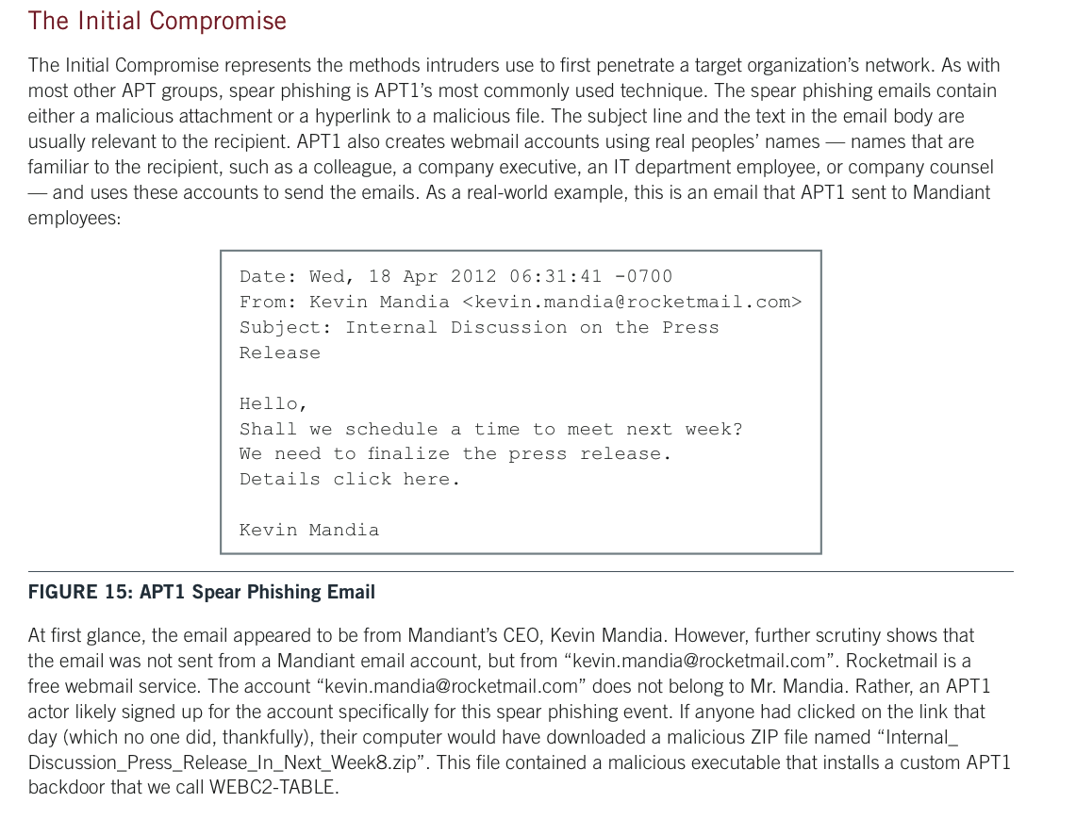

Slide 10
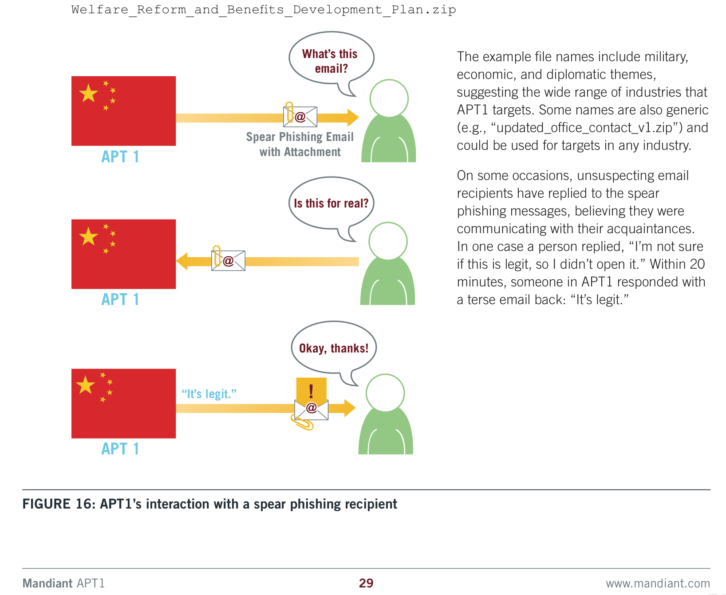
How not to authenticate an e-mail

Slide 11
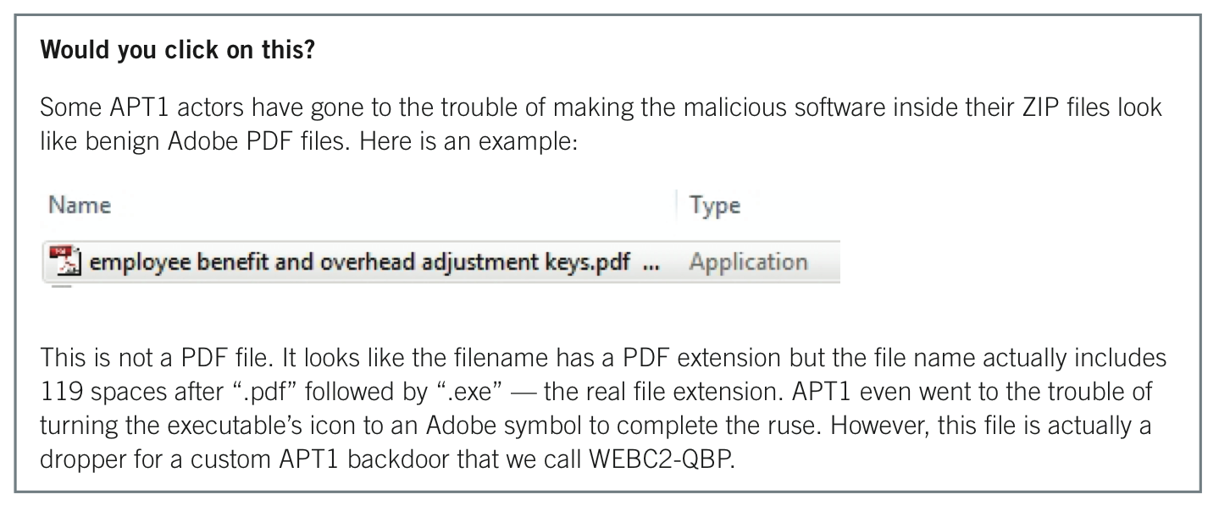
Click on it?

Slide 12
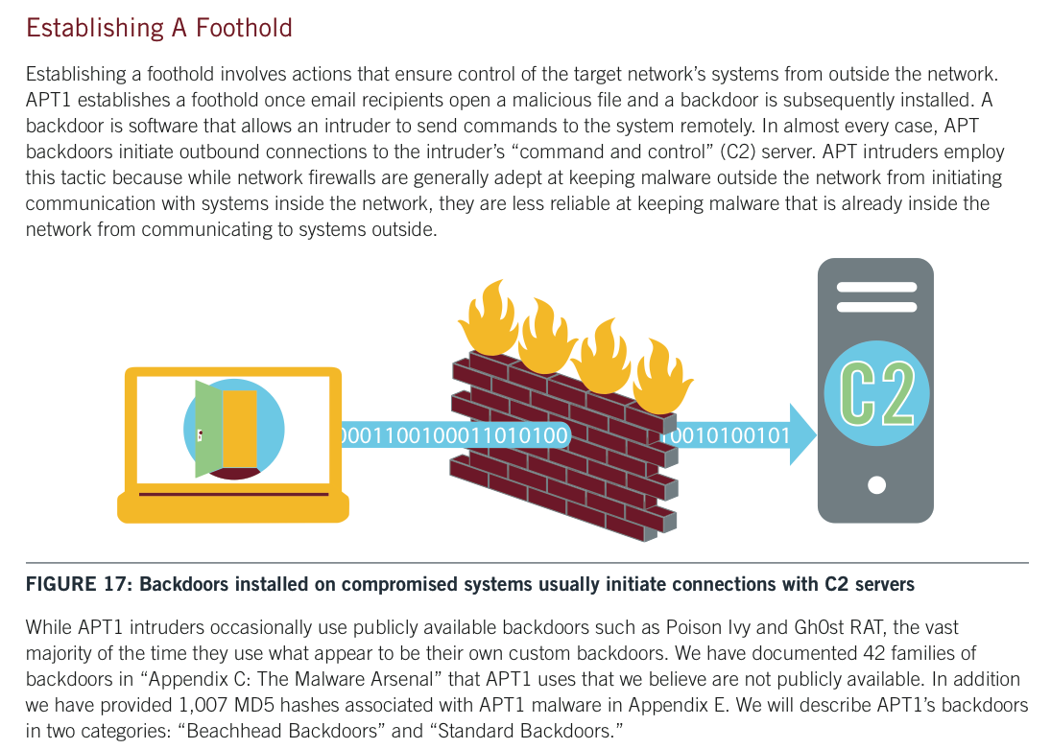

Slide 13
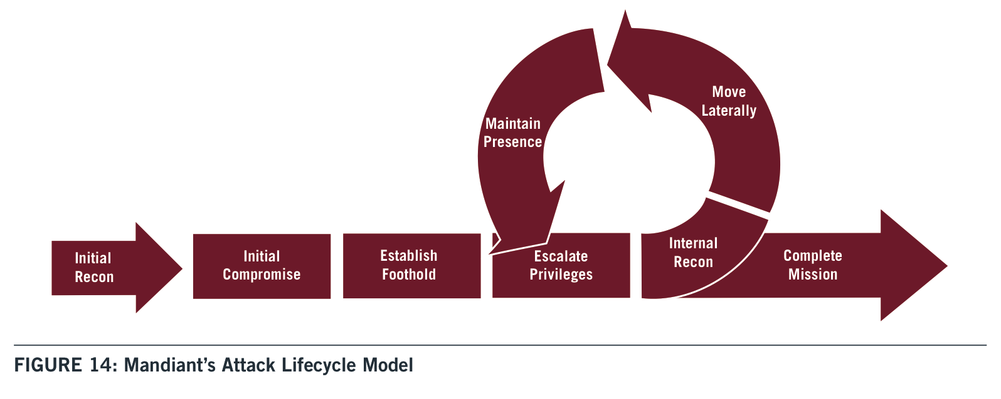
Typically open with a spear phishing attack containing a trojan horse
Spread to other users or machines.
Privilege escalation
to compromise trusted software or accounts
(e.g., pass-the-hash)

Slide 14
Step 2: Spread and escalate
By worm. Infect new nodes on the target network.
StuxNet RCE: MS08-067 (also used by Conficker).
Sandworm Nyetna: EternalBlue RCE
By privilege escalation. Obtain credentials for additional user accounts (e.g., root!) and log in remotely.
Pass-the-hash attacks on Windows (e.g., WDigest)
E.g., tools with root can harvest password hashes out of memory of authentication services.
Mimikatz: hack tool with various credential exploits for MS-Windows, used in DigiNotar attack and others.

Slide 15
Pass-the-hash
MS-Windows networks use(d) password hashes to authenticate internally. (???)
Pass-the-hash malware harvests <username, pwdhash> credentials from a compromised system to gain their privilege elsewhere in the network.
[https://www.hacking-lab.com/misc/downloads/event_2010/daniel_stirnimann_pass_the_hash_attack.pdf]

Slide 16
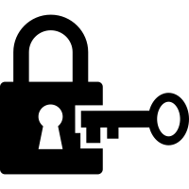


Cyberphysical
exploit
vulnerability
Step 3
Let’s get

Slide 17
Stuxnet: EquationGroup 2008-10
Windows worm/rootkit platform.
Conceal self: rootkit lies dormant and undetected.
Spread within enterprise by RCEs—zero-day or older.
E.g., 4 including MS08-067—also used by Conficker.
Also spread across “air gaps” by USB drive.
Payload: Search for nodes running Siemens PCS7/STEP7 industrial control software (SCADA).
Exfiltrate industrial info to external command nodes.
Attack/reprogram targeted devices when present.
Destroys 1000+ centrifuges for uranium enrichment at Iran Natanz facility: spin, wobble, self-destruct.

Slide 18
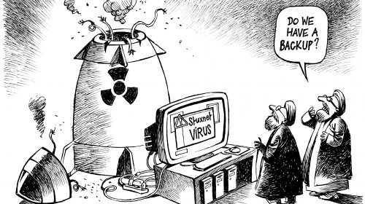
Impact of Stuxnet
https://www.chappatte.com/en/images/page/55/

Slide 19

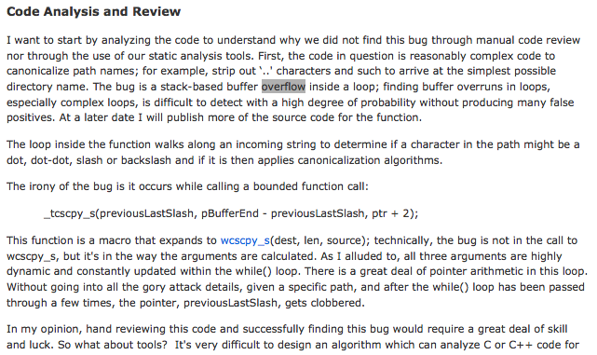
http://blogs.msdn.com/b/sdl/archive/2008/10/22/ms08-067.aspx

Slide 20
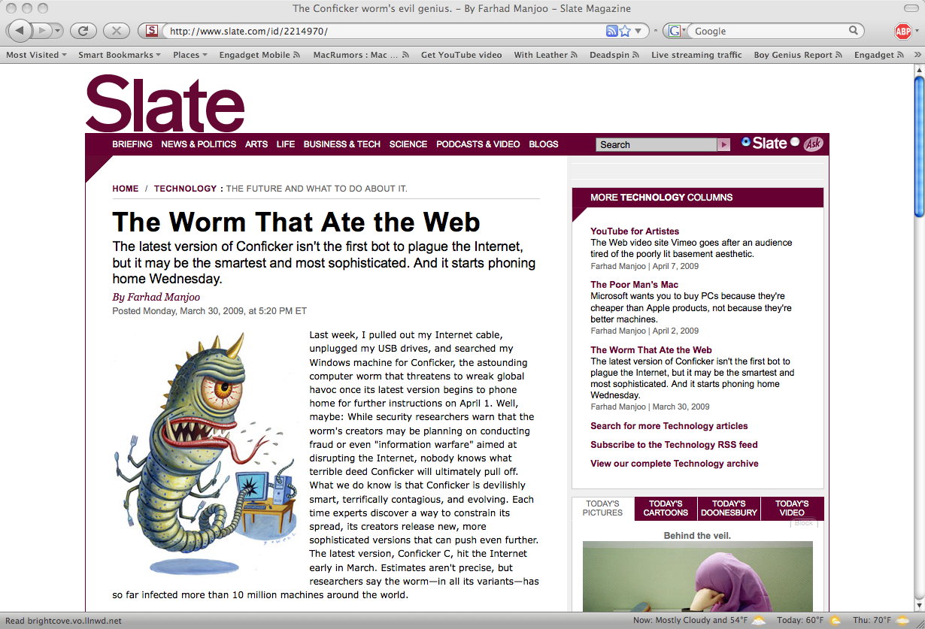
Conficker also used ms08-067 RCE

Slide 21
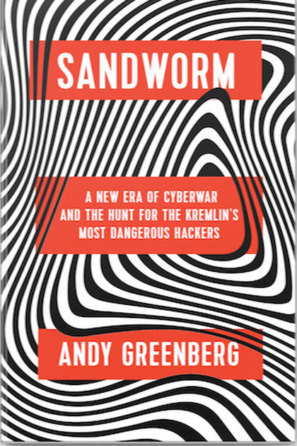

Sandworm attacks on Ukraine
Sequence of evolving attacks, e.g.:
“Christmas blackout” 2015
Telebot blackout, 12/17/16
Constitution Day shutdown 2017
Attacks power grid:
Remote operator control (2015)
“Industroyer” telebot (2016): rapid-fire industrial control commands
Also “kills” computers to slow recovery
KillDisk (2014-2015)
NotPetya “ransomware” (2017)

Slide 22
NotPetya (Nyetna)
Inject by trojan horse on a legitimate software update.
Infected M.E.Doc: “Ukrainian Quicken” for enterprise accounting.
Spread by automated software updates to…everyone.
Distribute hidden command-and-control through web cookies on M.E.Doc sessions. Launch on Ukraine Constitution Day 2017.
Spread within enterprise by multiple exploits:
MimiKatz pass-the-hash
EternalBlue RCE
Payload: Petya ransomware as a cover.
But no decryption key→NotPetya! Acts as KillDisk.
Unrepairable machines slow recovery.

Slide 23
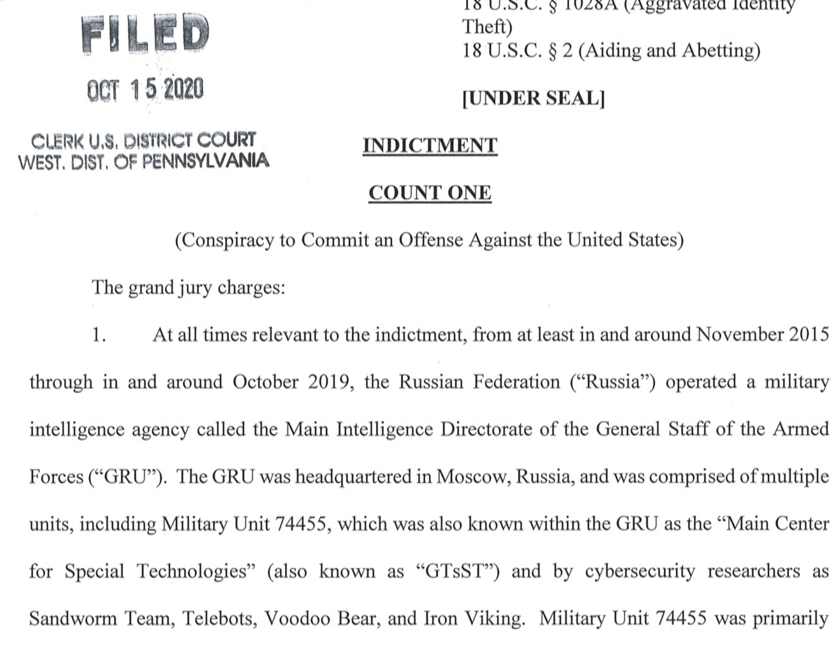

Slide 24
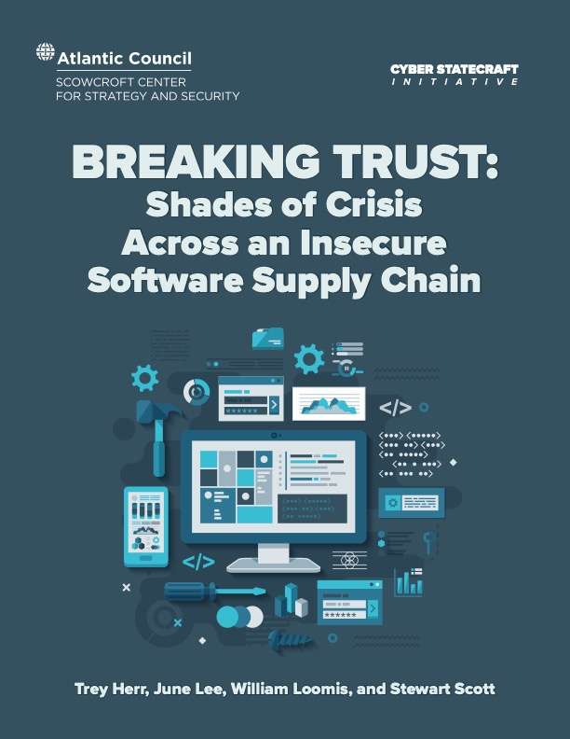
Issue: software supply chain
Where did you get those tools?
Enterprises you trust might be subverted to attack you.
With or without their knowledge and consent? Who knows?
Example: NotPetya trojan in commercial software updates.
Vulnerabilities in libraries and tools can spread far and wide.
Example: Ripple20
Summer 2020
https://www.atlanticcouncil.org/programs/scowcroft-center-for-strategy-and-security/cyber-statecraft-initiative/breaking-trust/

Slide 25
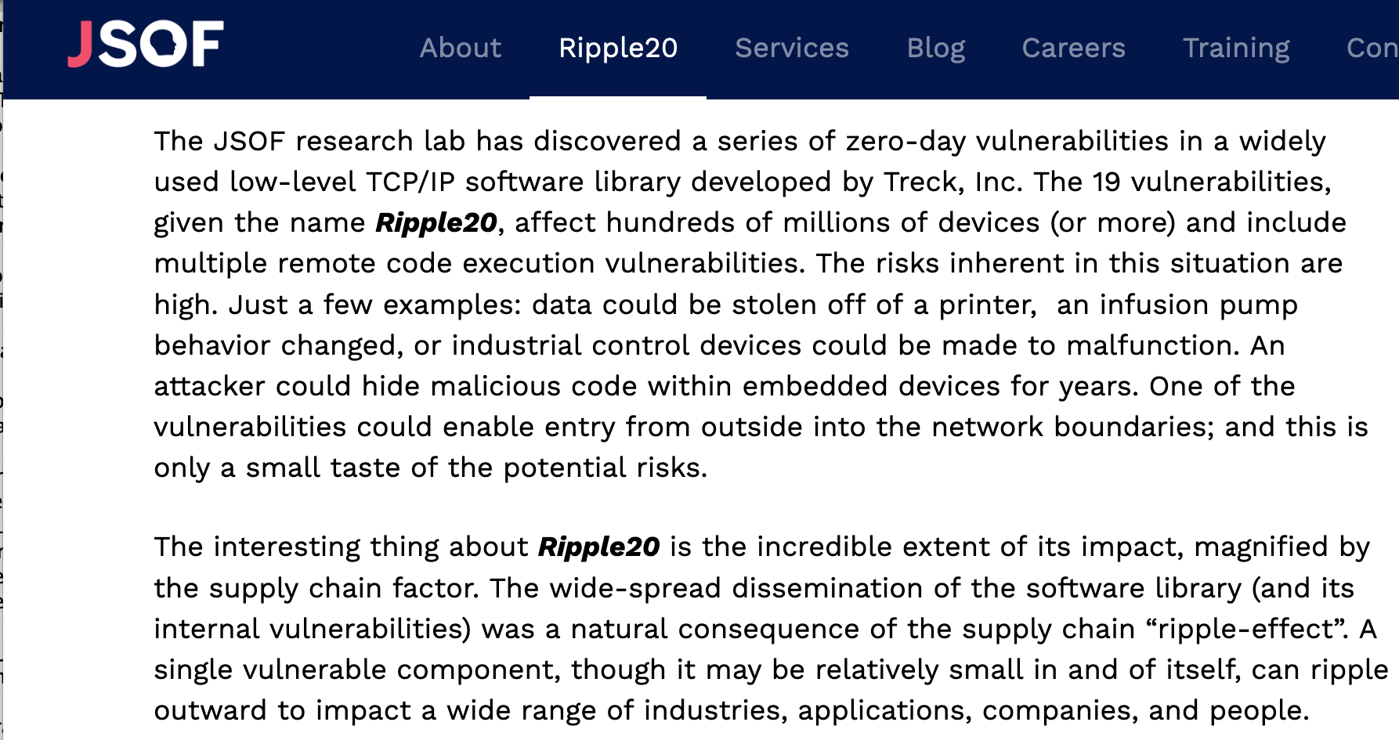
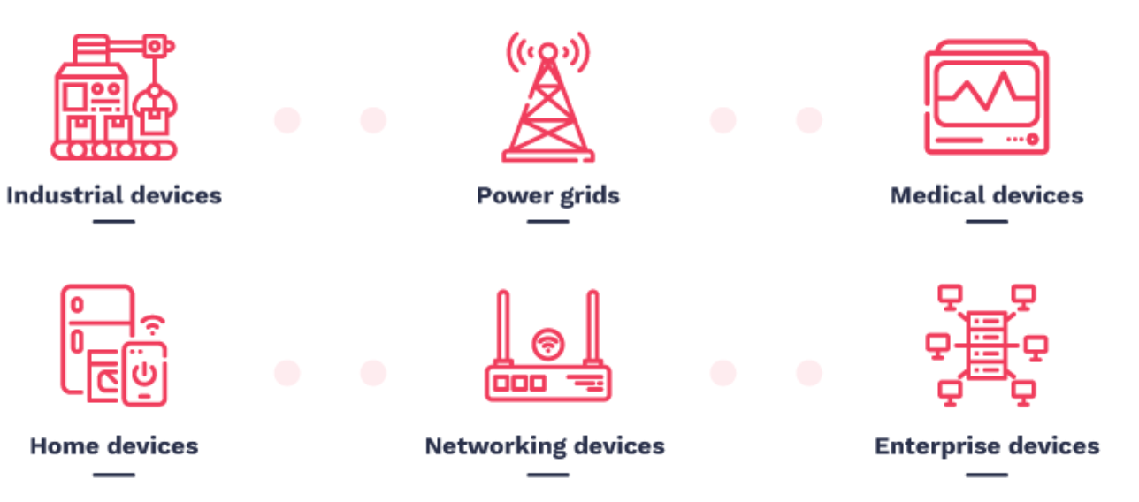
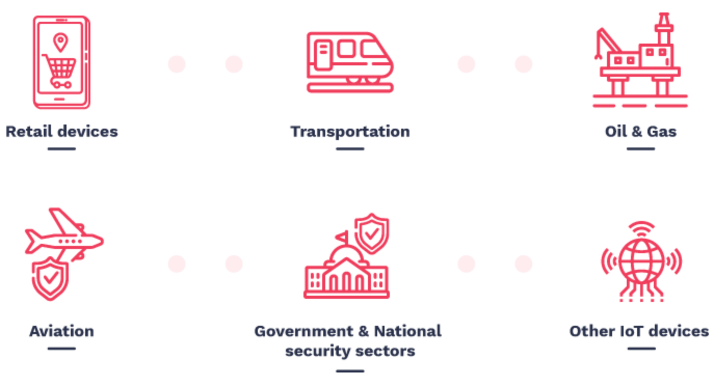
Ripple20
https://www.jsof-tech.com/ripple20/

Slide 26
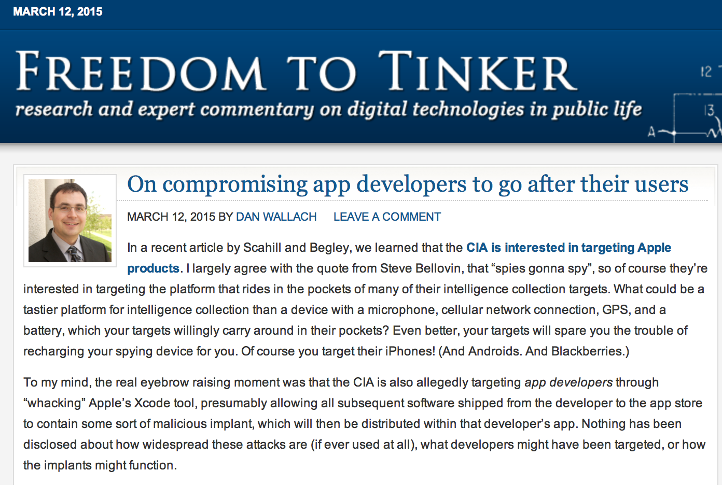

Slide 27
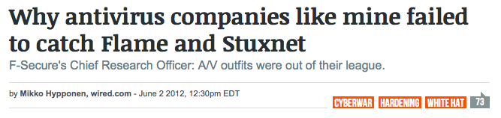
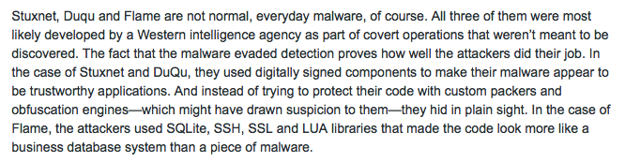
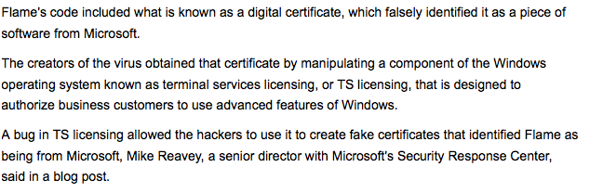

wired.com, June 2012
Reuters, June 2012

Slide 28
Issue: government zero-days
What if a government obtains a zero-day?
E.g., a vulnerability in software used by civilians, possibly commercial software used in enterprises.
Option 1: Disclose it?
The right thing to do, right? The vendors can fix the flaw, and everyone is safer.
Option 2: Keep it secret?
Yes, “we” are vulnerable, but “they” don’t know!
“They” are vulnerable too, and we know!
Use it?

Slide 29
The EternalBlue story (2017)
EternalBlue is/was a zero-day RCE in Windows.
EquationGroup (US NSA) had it and kept it secret.
Leaked to or hacked by foreign group ShadowBrokers.
March. Microsoft discovers/patches vulnerability.
April. ShadowBrokers releases it on the open Internet.
May. WannaCry ransomware infects unpatched systems worldwide (attr. North Korea).
But shut down by hidden DNS kill switch!
June. Ukraine Constitution Day attacks.
Disaster for unpatched enterprises worldwide.

Slide 30
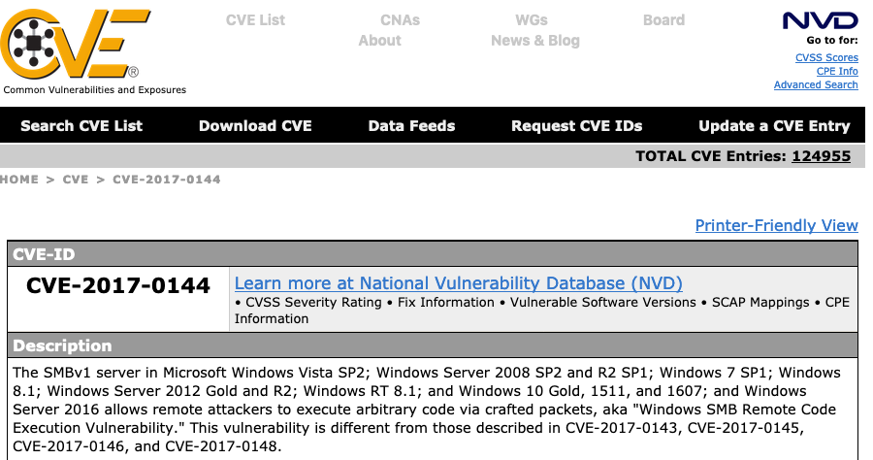
EternalBlue (CVE-2017-0144)

Slide 31
WannaCry

Slide 32

A Hobbesian future?
Thomas Hobbes: Leviathan (1651)
Humans driven by self-interest
Greed and fear
No law in the state of nature
Life is “solitary, poor, nasty, brutish, and short”.
Humans need governance. But by whom?
Who is in charge here?
Reference: https://yalebooksblog.co.uk/2013/04/05/thomas-hobbes-solitary-poor-nasty-brutish-and-short/

Slide 33
Where are we headed?
“If we don’t watch where we’re going, we’ll end up there.”
Significant vulnerabilities: asymmetric whack-a-mole
Cross-border threats: crooks, terrorists, state actors
Crypto genie is out of the bottle: blinded eyes and ears.
Governments must respond.
Offensive or defensive? By due process, or in secret?
Snowden leaks (2011) revealed that US-NSA was hacking US individuals and companies.
US military cyber-command cleared for offensive ops.
Who is the adversary now? Who is the target?

Slide 34
Cyberwar and politics
Mueller investigation: Russian GRU unit took steps to influence and threaten 2016 election.
Fancy Bear (Sandworm?)
Podesta/DNC/wikileaks hack-and-dump
Rumor: US offensive cyberops protected 2018 election.
Needed: cyberlaw, careful planning and policy.
Accountability? Attribution is tricky, often deniable.
Cyberwar as a tool of private warlords?
Issues: revolving door to corps, privacy shield, no global regulation. Civil liability tested in courts now.

Slide 35
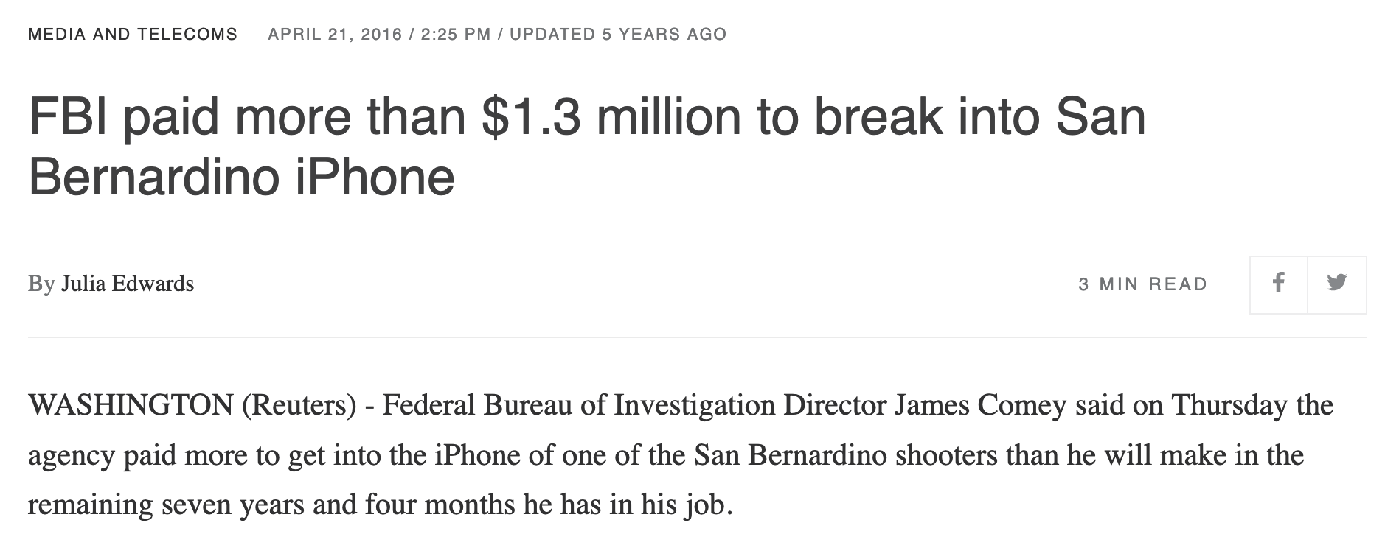
The crypto problem
Reuters. The Justice Department said in March it had unlocked the San Bernardino shooter's iPhone with the help of an unidentified third party and dropped its case against Apple Inc AAPL.O, ending a high-stakes legal clash but leaving the broader fight over encryption unresolved.
Comey said the FBI will be able to use software used on the San Bernardino phone on other 5C iPhones running IOS 9 software.

Slide 36
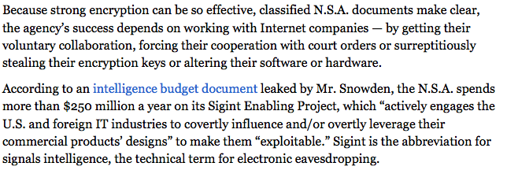
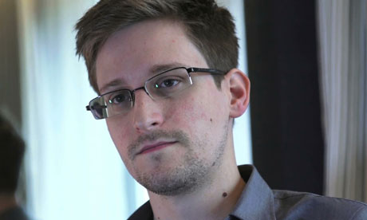

http://www.propublica.org/article/the-nsas-secret-campaign-to-crack-undermine-internet-encryption

Slide 37
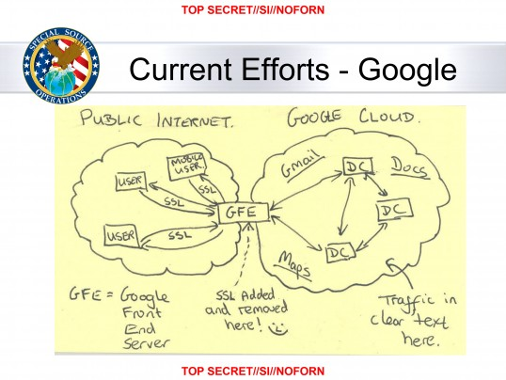
Also in the news, the Snowden NSA leak for Hallowe’en 2013. Scary?

Slide 38
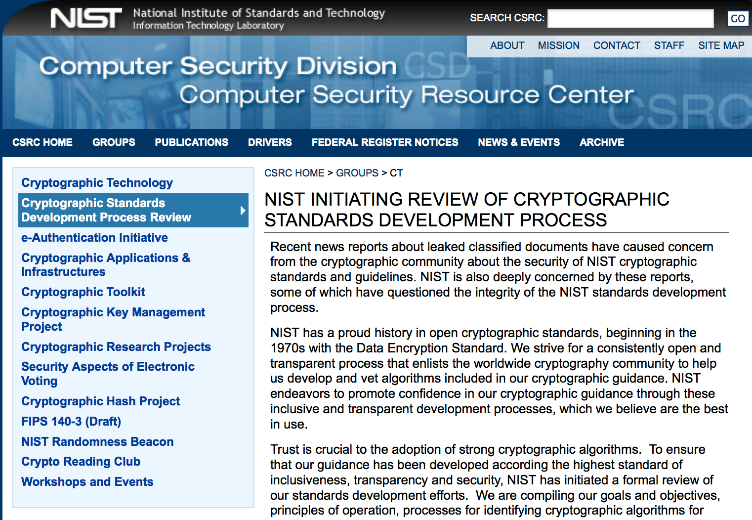
Where did you get those tools? 11/1/13

Slide 39
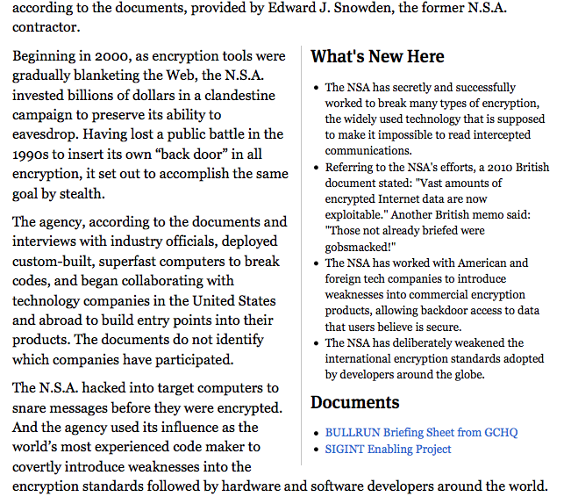
http://www.propublica.org/article/the-nsas-secret-campaign-to-crack-undermine-internet-encryption

Slide 40
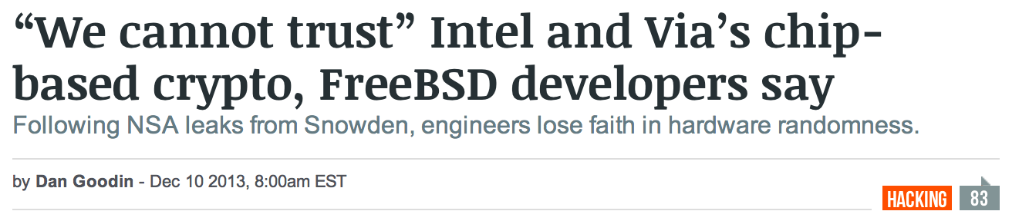
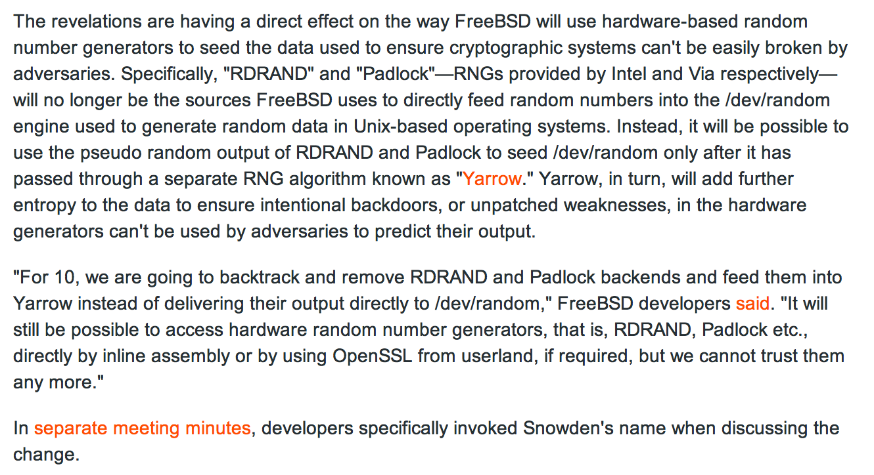

Slide 41
